Slide 1
Algorithmic Curation and Causal Analysis over Scientific Data Repositories
Bill Howe, Ph.D.
Associate Professor, Information School
Adjunct Associate Professor, Computer Science & Engineering
Founding Associate Director, eScience Institute
Notes:
Thank you for the opportunity to be here.

Slide 2
The next 15 min…
Online Data Repositories
Unsupervised Curation
Automatic Claim Verification
Notes:
I’d like to talk to you today about some very recent work we’ve been doing across machine learning, data management, and domain science, but I want to start by giving some background about my interests.

Slide 3
In one slide….
If you make some statistical claim, you’re increasingly expected to share the data for reproducibility purposes
It works: lots of big public data repositories are online
But these repositories are embarrassingly underused
Bad keyword search is about all you get (crappy metadata)
Schemas, standards, and wrist-slapping don’t work
The forward edge of research can’t be standardized, by definition
So: New algorithms to automate curation, data integration, and statistical claim-checking

Slide 4
Replication crisis; here social psychology
… we showed that physical cleansing alleviates the upsetting consequences of unethical behavior and reduces threats to one's moral self-image. Daily hygiene routines such as washing hands, as simple and benign as they might seem, can deliver a powerful antidote to threatened morality, enabling people to truly wash away their sins
Zhong & Liljenquist (2006), Science
Notes:
Some fields that are relatively new to quantitative methods are perhaps most vulnerable to
People who “cleansed” with antiseptic wipe were less likely to agree to volunteer to help someone (40% of those who cleansed agreed vs 70% of those who didn’t).

Slide 5
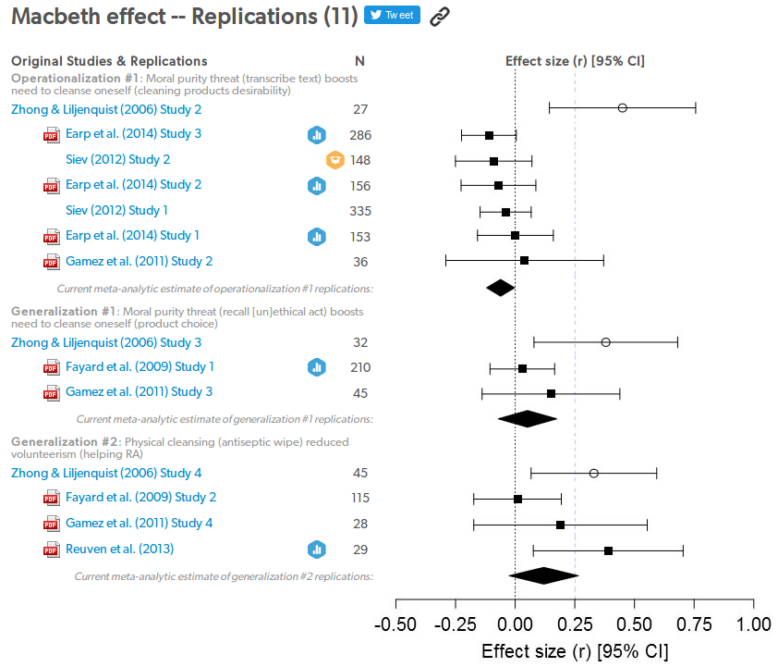
Replication crisis in social psychology
Notes:
Generalizatoin 2 - people who “cleansed” with antiseptic wipe were less likely to agree to volunteer to help someone (40% of those who cleansed agreed vs 70% of those who didn’t).

Slide 6
The good news: Science data is increasingly pooled in public repositories, with varying degrees of success
2,000+ Science Data Repositories
source: r3data.org
“upload any file format” (2M articles, 800k uploads)
Pangea
strict metadata standards;
$350M infrastructure project; ~0 datasets ever uploaded
Arctic data center
constraints in format, metadata, quality
(promised) capabilities, automation
Notes:
The good news is that there has been some success in aggregating data in public repositories. Funding agencies and journals have partnered to make it a requirement that data (and sometimes code) be published online alongside the paper.
But there have been some spectacular failures in this space as well. CaBIG was an attempt to standardize and organize all cancer research data, to the tune of $350M of NIH money, but the project was killed before there was any significant amount of data – in the autopsy papers that have come out, there’s an argument that it was too restrictive – too hard to get data in, too hard t oget data out.
Meanwhile, very loosely structured repositories like figshare are doing pretty well. Many other successful repositories exist in particular domains.
So we have a situation where reproducibility is a big problem but there are big pools of data available, linked to papers. SO that’s an opportunity for a different approach
Figshare: 800,000 uploads,

Slide 7
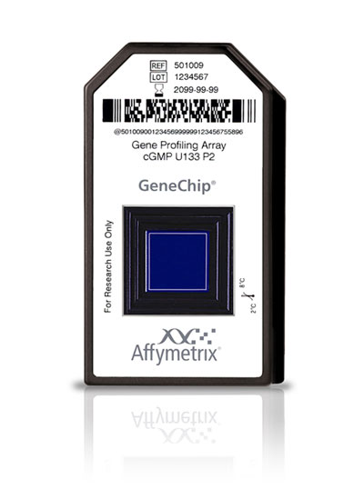
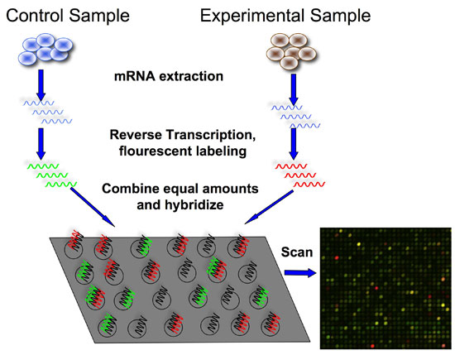
Example: Gene Expression Omnibus
Gene expression data (here, microarray)
“Gene X correlates with Gene Y in male smokers age 30-35”
“Gene X expressed more highly in patients under treatment Y than treatment Z”

Slide 8
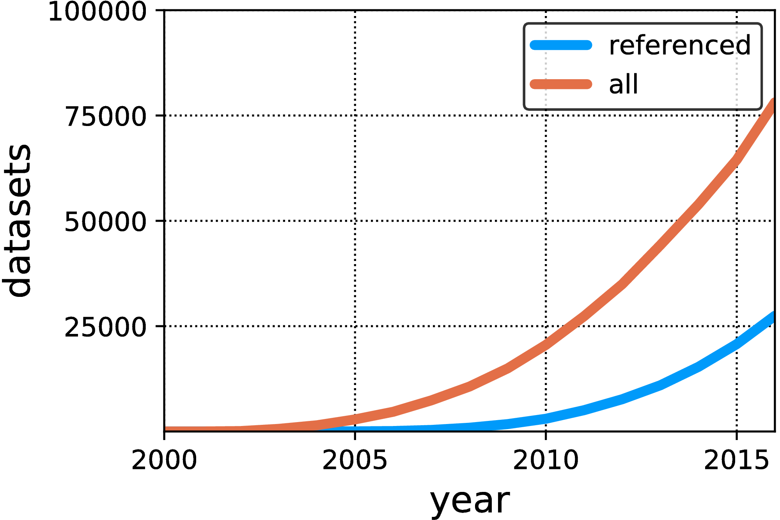
LLD@NIPS 17, IJCAI 18
Good news, bad news
Maxim Gretchkin
Hoifung Poon
GEO data
Lots of data available, far less actually referenced
Notes:
Google knowledge graph
Specialized Ontologies

Slide 9
Why aren’t more people using the data?
One reason: The metadata is terrible:
 | Precision | Recall
“liver” | 40% | 57%
“kidney” | 59% | 100%
Notes:
Explain Precision/Recall

Slide 10
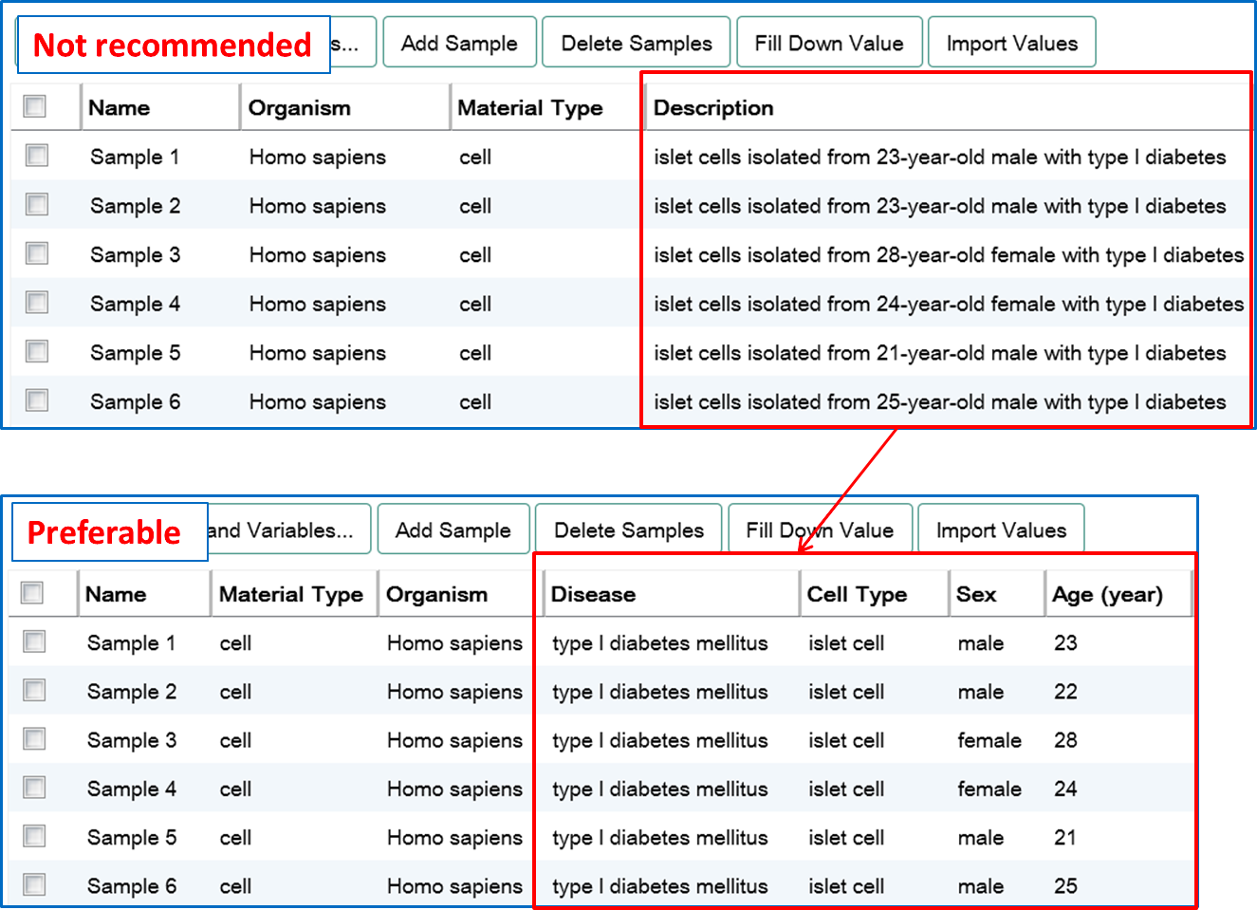
Conventional approach: blame the researchers
Source: ArrayExpress submission guide
Notes:
A non-trivial problem, the image is an easiest case

Slide 11
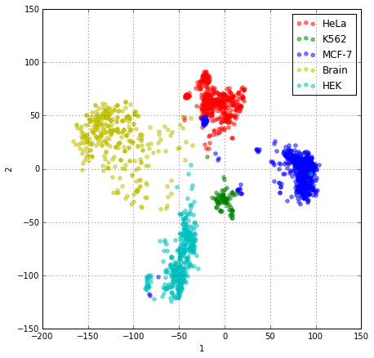
One idea: use the expression data itself to learn correct labels
Maxim Gretchkin
Hoifung Poon
color = labels supplied by researchers
clusters = 1st two PCA components on the gene expression data itself
The expression data and the text labels appear to disagree
Notes:
"HeLa", "K562", "MCF-7" and "brain tumor”
PCA on expression values

Slide 12
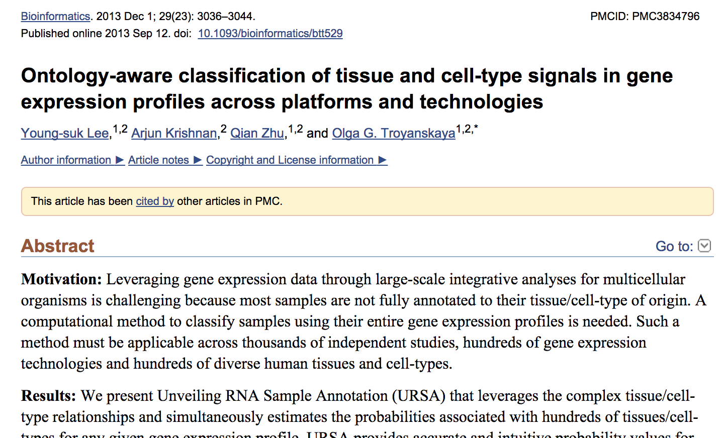
State-of-the-art: Lee et al., supervised annotation, the URSA algorithm

Slide 13
Problems with supervised learning….
Training data is expensive; requires subject matter expertise
Class labels / ontology / lexicon aren’t stable
Different communities may use different ontologies
Contains errors; hard to prove it’s perfect
Transfer learning doesn’t work; these aren’t pictures of cats
Claim: Supervised learning is a poor fit for science in general…

Slide 14
“Organic” supervision
LLD@NIPS 17, IJCAI 18
Maxim Gretchkin
Hoifung Poon
Given:
A Lexicon of canonical labels L
A set of data items (D_{i},T_{i}) where D_{i} is data and T_{i} is free text.
Ex: Datasets + text descriptions in a sci. repository
Ex: Figures + captions
Ex: Photos + news stories
Ex: Art + description
Ex: Videos + comments
Assign each pair (D_{i},T_{i}) with a label from L

Slide 15
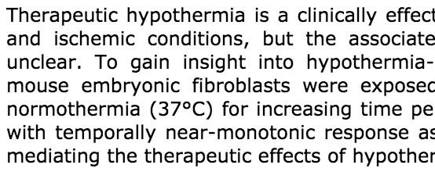
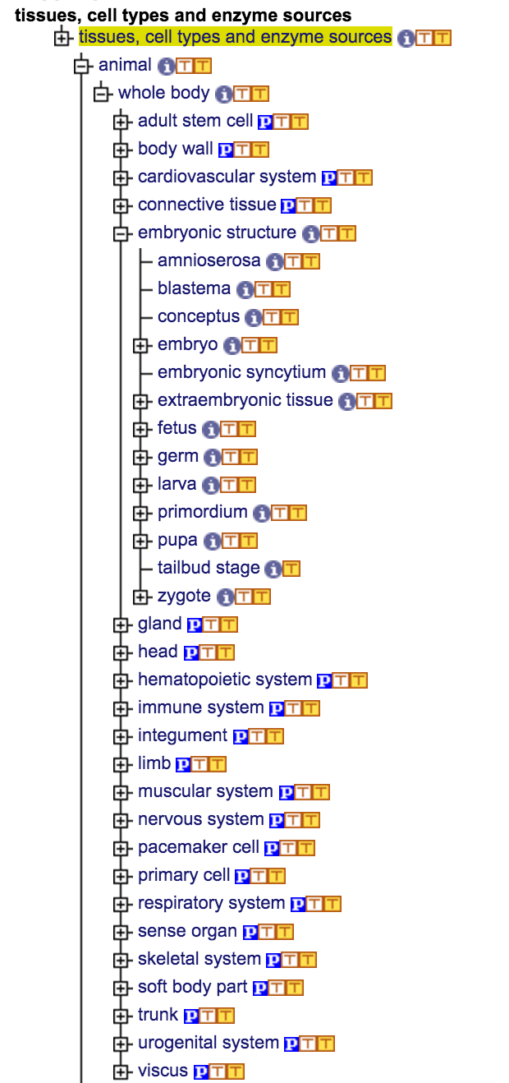
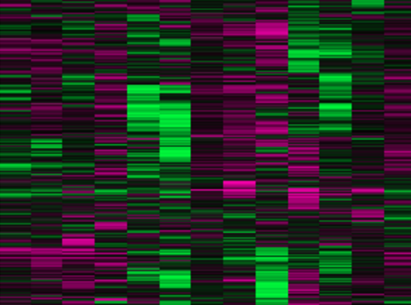
Free-text Metadata
Domain knowledge (Lexicon)
Maxim Gretchkin
Hoifung Poon
Text Classifier
Co-training
Data Classifier
Expression data
Better Tissue Type Labels
Notes:
Google knowledge graph – common knowledge, high redundancy, possibly crowdsourcing (visual: question answering via Google)
Text features:
presence of ontology terms
sibling of ontology term
Expression features

Slide 16
EZLearn: Distant supervision + co-learning
LLD@NIPS 17, IJCAI 18
Maxim Gretchkin
Hoifung Poon
Data sample
Main Classifier
Lexicon
Text description
Distant supervision
.
.
.
Co-training
Auxiliary Classifier

Slide 17
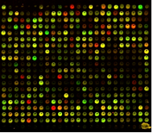
Tissue annotation problem
Data sample
Text description
.
.
.
Summary
… Enriched tumor-initiating capacity has been linked to poorly differentiated glioblastoma cells sharing features with neural stem cells …
Characteristics
tissue: GBM-1

Slide 18
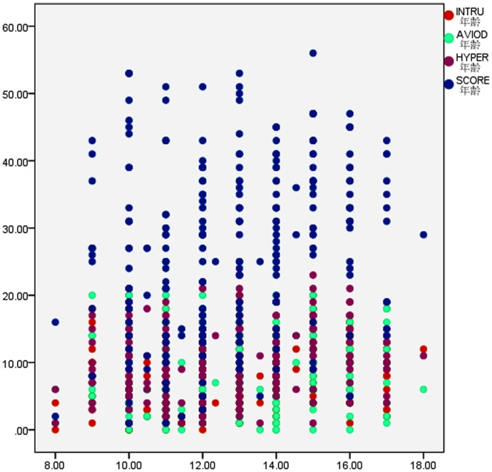
Figure comprehension problem
Data sample
Text description
doi:10.1371/journal.pone.0041741
.
.
.
Fig. 1: The scatter plot of regression analysis between CRIES score and age.
http://viziometrics.org/

Slide 19
EZLearn as a recipe (simplified)
Input: (Data, Text) pairs, and a lexicon X
Initialize with distant supervision: If a term c in C appears in Text verbatim, assign it as the label
Train a classifier F on the Data using current text labels; classify all data samples. using F
Train a classifier G on the Text using labels from step 2; classify all text descriptions using G
Go to Step 2
Data sample
Text description

Slide 20
One decision: Combining labels from two classifiers
Standard: Just use original exact matches
Predict: Just use image classifier labels
Union: Return their union
Intersect: Return their intersection
Relation: Remove general terms if a more specific term is available

Slide 21
Evaluation

Slide 22
Tasks
Gene expression tissue prediction:
116,895 expression samples (think 20k-D vectors)
4931 possible tissue labels
Almost all samples have label mentions, ~3.5 different labels mentioned on average
Scientific figure classification:
1.2 million images from scientific papers
24 possible labels (and growing)
< 10% of the samples have label mentions

Slide 23
Classifier details
Main Classifier
Logistic Regression
Gene expression: Learned embeddings via autoencoder
Figure classification: pre-trained ResNet-50
fastText
Gene expression: dataset summary + sample characteristics
Figure classification: figure captions
Auxiliary Classifier
https://research.fb.com/fasttext/

Slide 24
Ontology-based precision/recall
Whole body
Correct
Predicted
Hematopoietic system
Gland
Up(Correct)
Blood
Bone marrow
Liver
Kidney
Up(Predicted)
Leukocyte
Monocyte
Macrophage

Slide 25
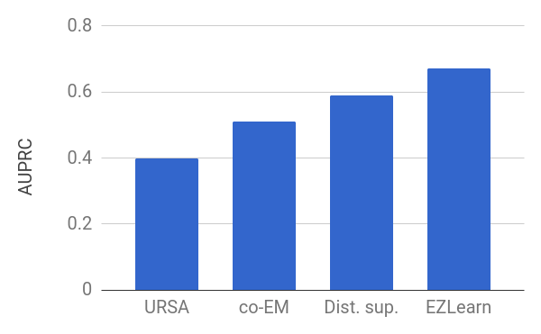
Tissue annotation evaluation
no labeled
15k labeled + rest of unlabeled
15k labeled samples
Notes:
URSA - 15k labeled samples
Dist.sup - 110k samples
co-EM - 15k labeled + the rest of unlabeled
EZLearn - no labeled

Slide 26
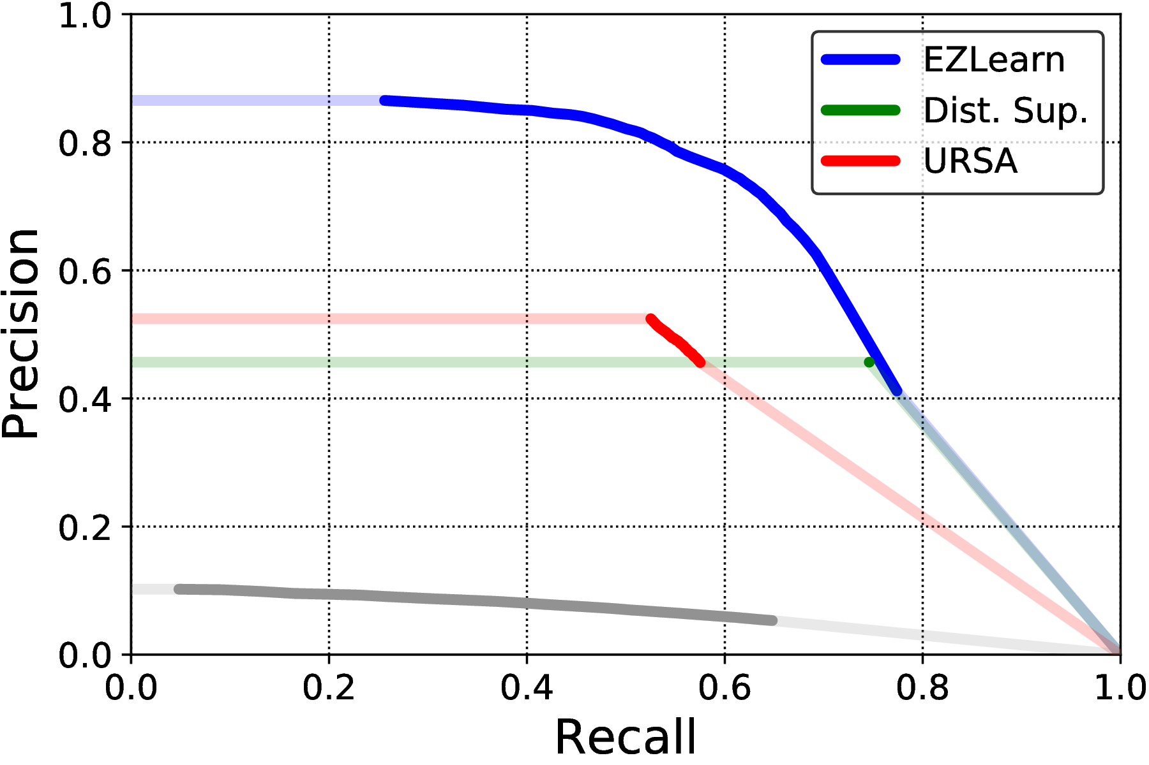
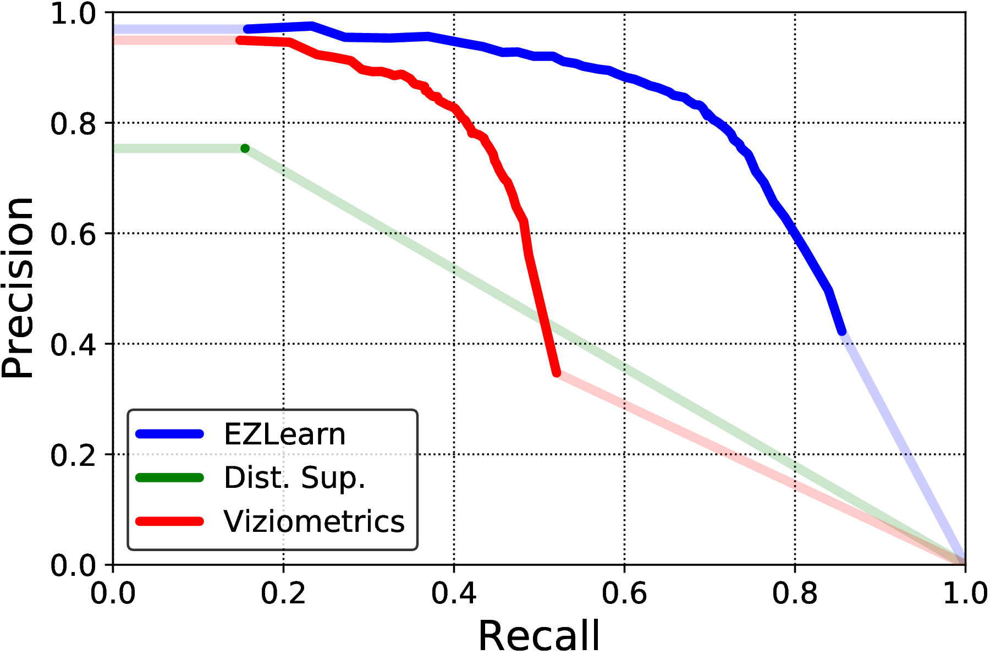
Precision-recall of the final classifiers
Gene expression tissue annotation
Scientific figure annotation
EZLearn significantly outperforms state-of-the-art supervised methods

Slide 27
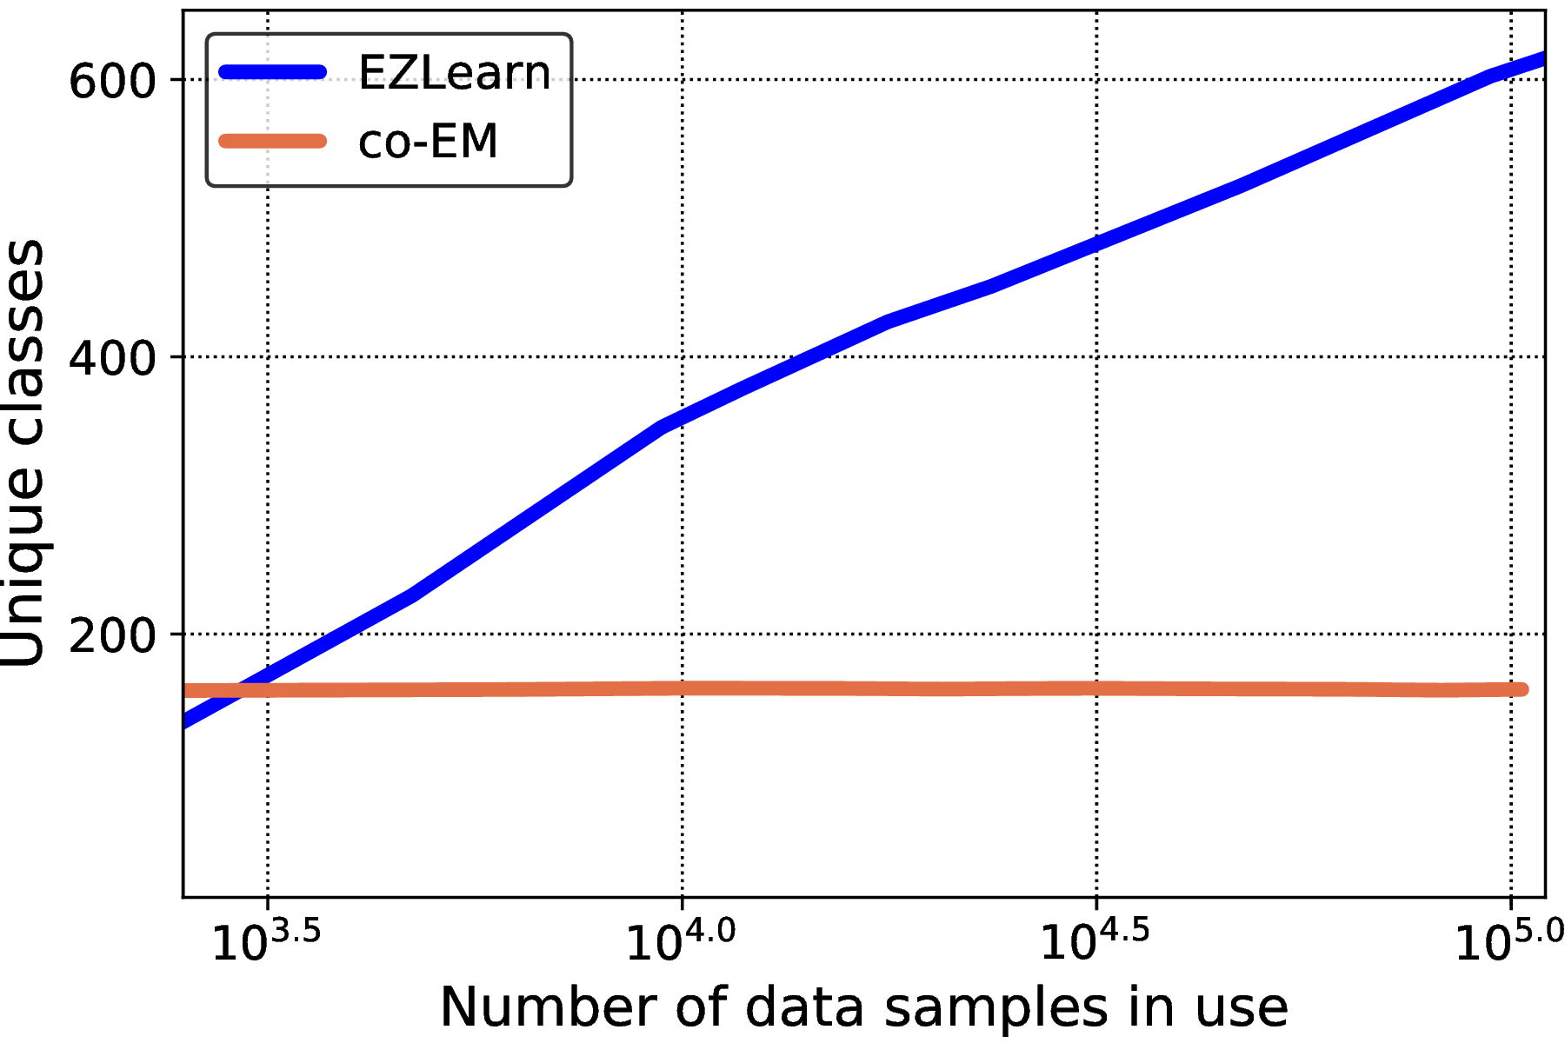
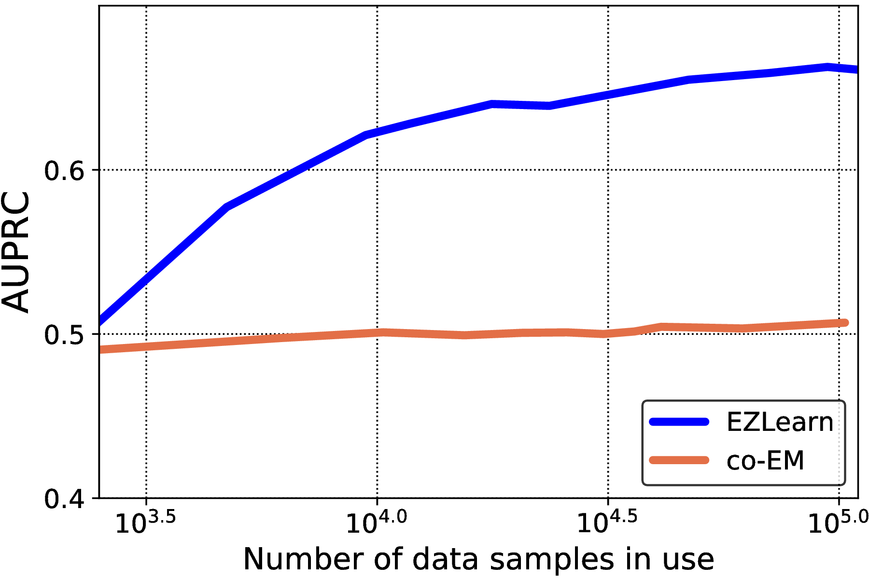
Learns new classes with new data
Co-EM can only learn labels that appear in the training data; EZLearn can pick up new classes from additional data

Slide 28
Surprisingly robust to noise in the text descriptions
Even when we shuffle the labels to simulate noisy, incorrect text descriptions, the co-learning approach is robust

Slide 29
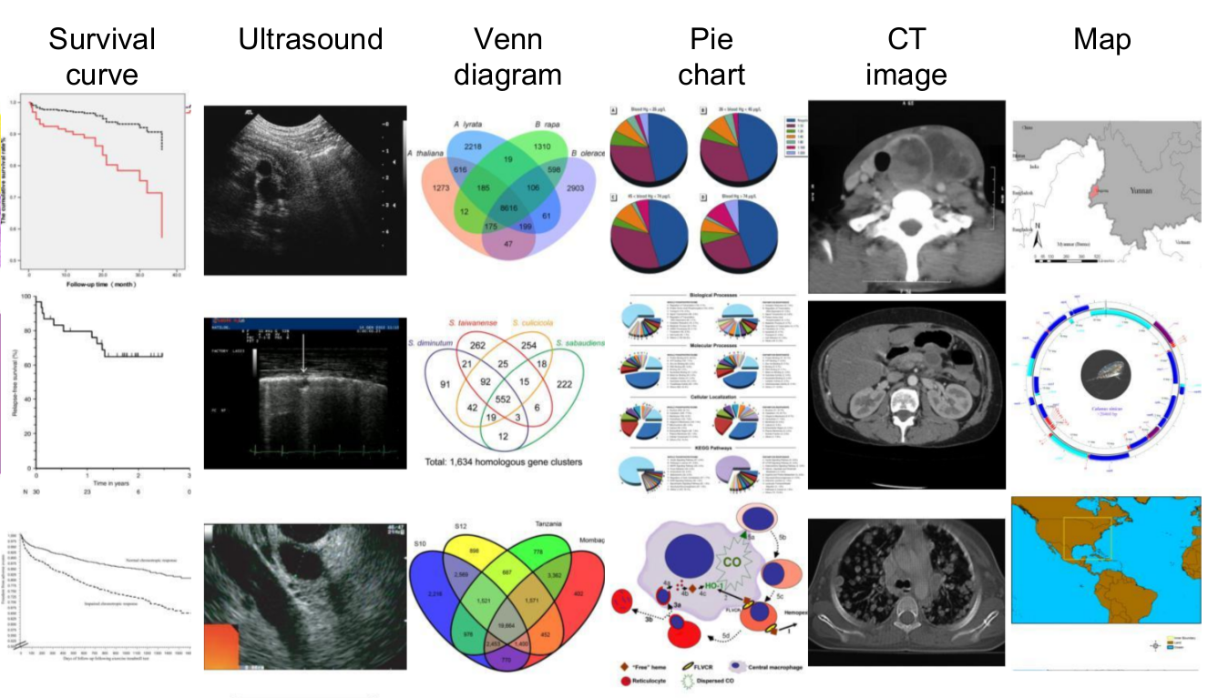
EZLearn curates figures into a fine-grained categories

Slide 30
Claim VErification

Slide 31
“Mean shift” claims
Differential Expression:
UMZAP-70+
MTZAP-70-
Paper
Gene name
Text
Claim: ARDS | ‘group’ = ‘UMZAP-70+’ > ARDS | ‘group’ = ‘MTZAP-70-’
Selector
Original dataset
Schema mismatch: “UMZAP-70” is called “class2” in the dataset
Analysis code:
select X from ... where class = ‘class2’

Slide 32
Find the right Schema Mapping
Find the mapping that maximizes the claim result, considering the string similarity of the schema
This is a discrete optimization problem, potentially exponential
Strategies:
Naive enumeration
Stochastic optimization - implemented using HyperOpt
Greedy - sort claims in the order of increasing complexity and solve one by one, fixing solved selectors

Slide 33
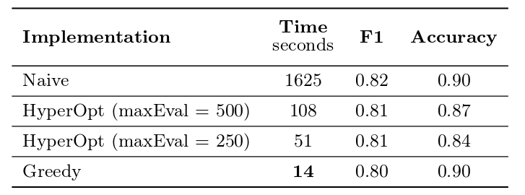
Performance
Notes:
Time to solve all 223 claims

Slide 34
ClaimJump: Generalizing claims
Generalizing a mean shift claim requires knowing the label in the new dataset (e.g. who is a smoker vs non-smoker)
Idea:
Train a classifier to recognize, say, “smoker” or “female” from genetic data
Use the classifier to impute/validate these labels on other people’s datasets where they are missing
Manage the uncertainty from the imputation using a Bayesian model
Run the mean shift test, modified by uncertainties
Generate reports

Slide 35
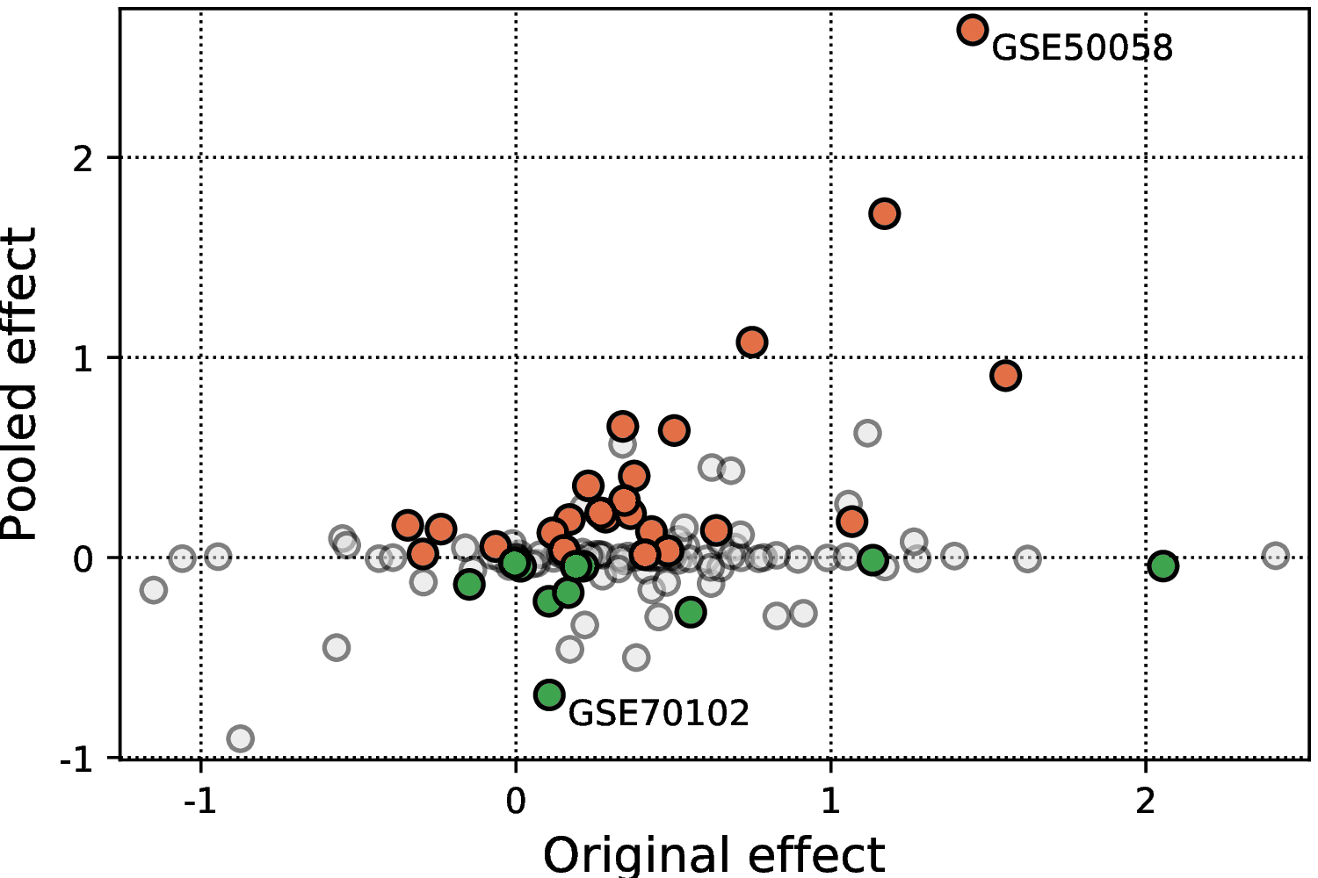
ClaimJump Does the data in the repository support your published claim?
Well-supported experiment
Repository

Slide 36
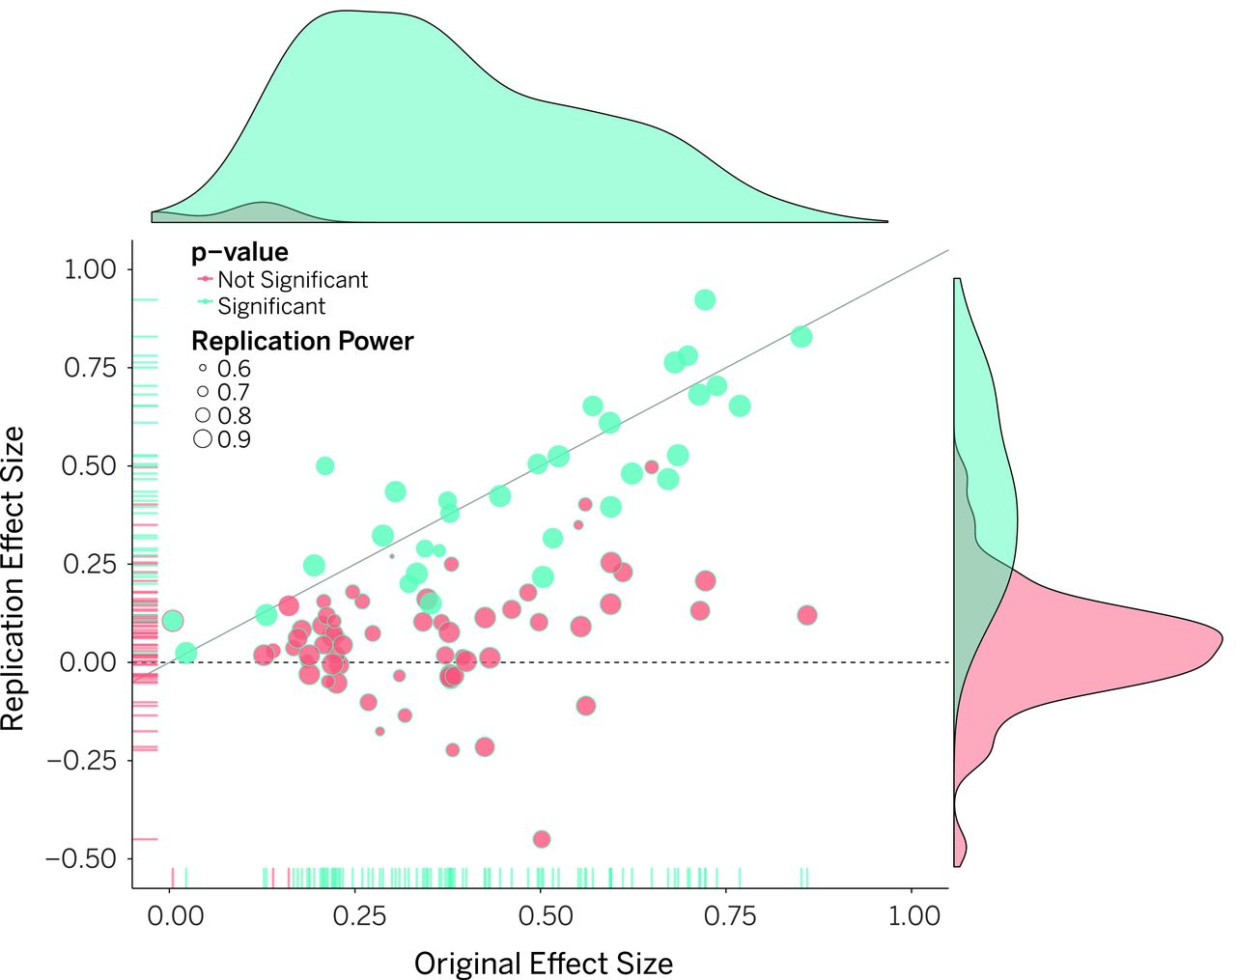
Science, 2015

Slide 37
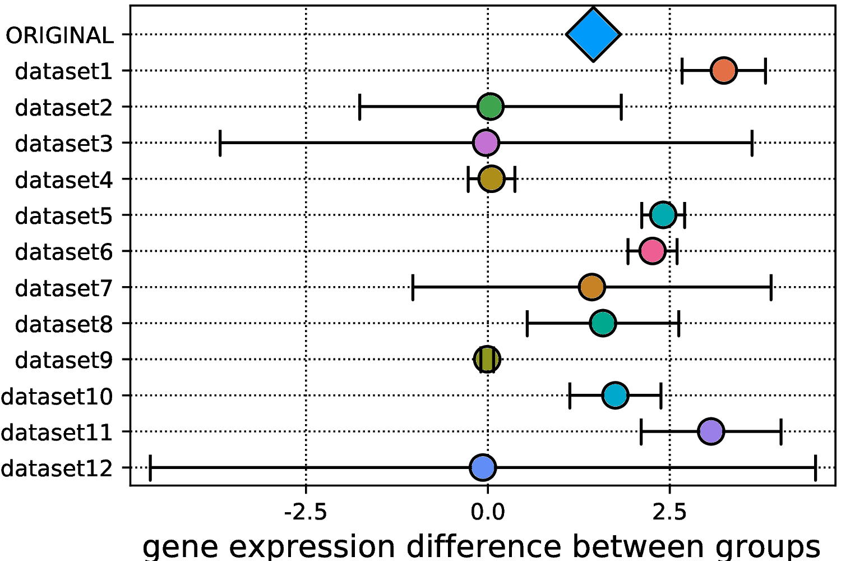
ClaimJump – Inspecting a specific dataset GSE50058
Used by original
Used by original
Published a year after original
Monitor the support for a published claim over time?
Send alerts when data violates previously published claims?
Monitor the statistical “health” of the repository over time?

Slide 38
Replication crisis in social psychology
Notes:
Generalizatoin 2 - people who “cleansed” with antiseptic wipe were less likely to agree to volunteer to help someone (40% of those who cleansed agreed vs 70% of those who didn’t).

Slide 39
Summary
Grechkin, Poon, Howe. “EZLearn: Exploiting Organic Supervision in Large-Scale Data Annotation”. NIPS LLD'17 workshop. Best Paper
EZLearn
combines distant supervision and co-training
outperforms previous supervised approaches, with zero training data
Naturally accommodates changing ontologies
Claim Verification
ClaimCheck: Assume the claim is true to disambiguate the schema mapping
ClaimJump: Impute missing columns in foreign data
Generate “report cards” for scientific claims, automatically
Just re-run it whenever your ontology changes.

Slide 40
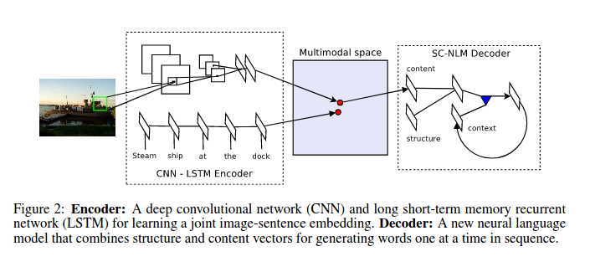
Next step:
Remove dependency on the ontology
Observation:
These aren’t pictures of cats; we can’t assume we know a universe of labels
Sean Yang
1) Visual Semantic Embedding
2) Learning embeddings for clustering
Parallel DEC
Clusters
3) Assign labels to clusters
A pair of text-image embedding from multimodal space

